Slide 1

Introduction to Robotics
CSE 461
Riad Ahmed
Lecturer, Dept. of Computer Science and Engineering
Brac University
Lecture 3: Chapter 1(Introduction to robotics: basics)

Slide 2
Previous Class
Primitives

Slide 3
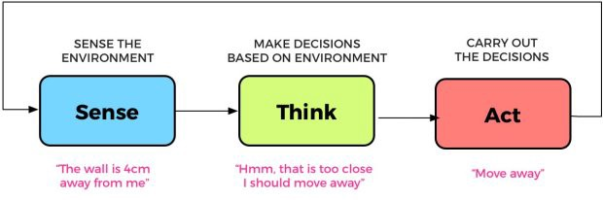
Recall

Slide 4
Paradigms of Robotics

Slide 5
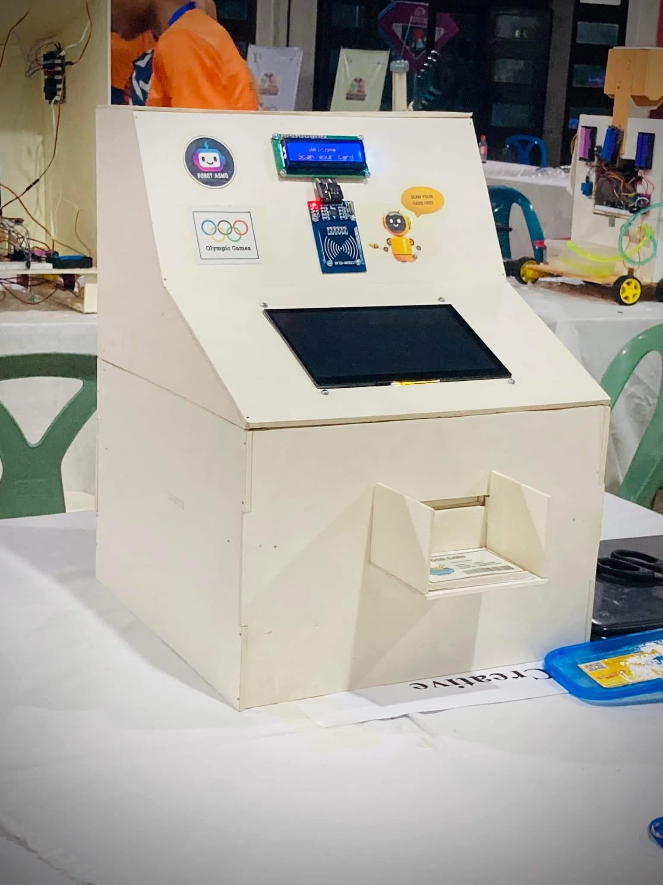

Slide 6
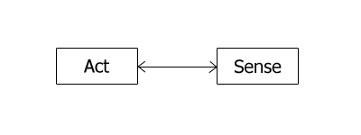
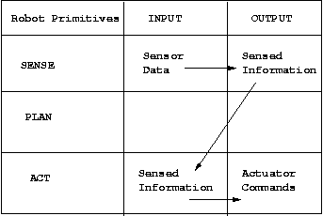
Reactive Paradigm

Slide 7


Slide 8
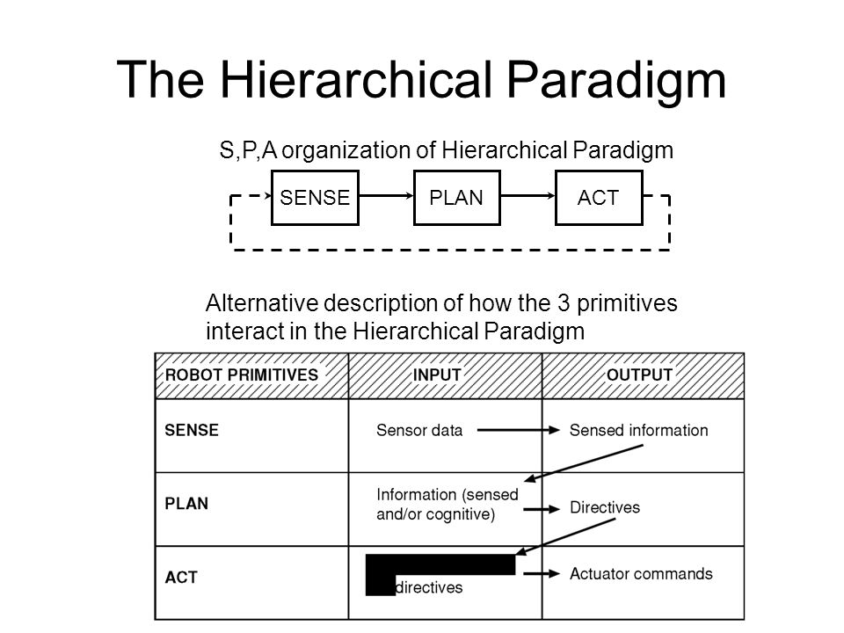

Slide 9
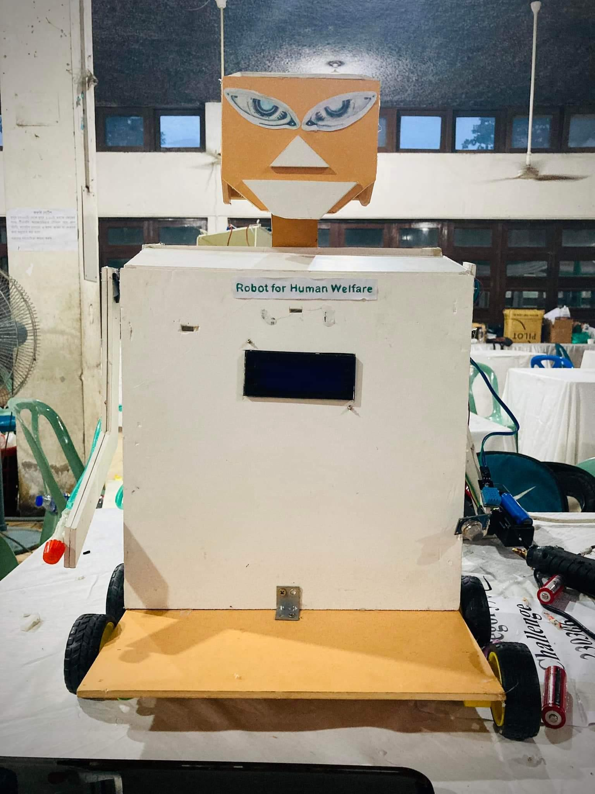

Slide 10
Hybrid deliberative/reactive paradigm
PLAN
SENSE
ACT
SENSE
ACT
SENSE
ACT

Slide 11
Advantages
Asynchronous processing technique allows to function Independently
Planner can slowly compute next goal while robot can perform reactive task

Slide 12
Local and Global Model
Reactive for Local control
Deliberative for Global control
However; Robot behavioral management requires to know its current mission, state and environment beside path-planning, map-making, monitoring etc. So, both local and global models are required to be considered for a robot performance.

Slide 13
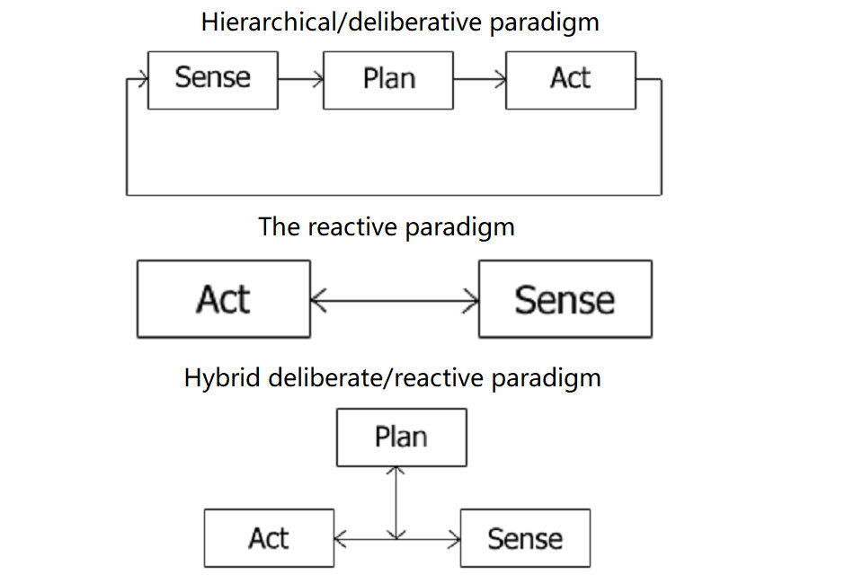

Slide 14
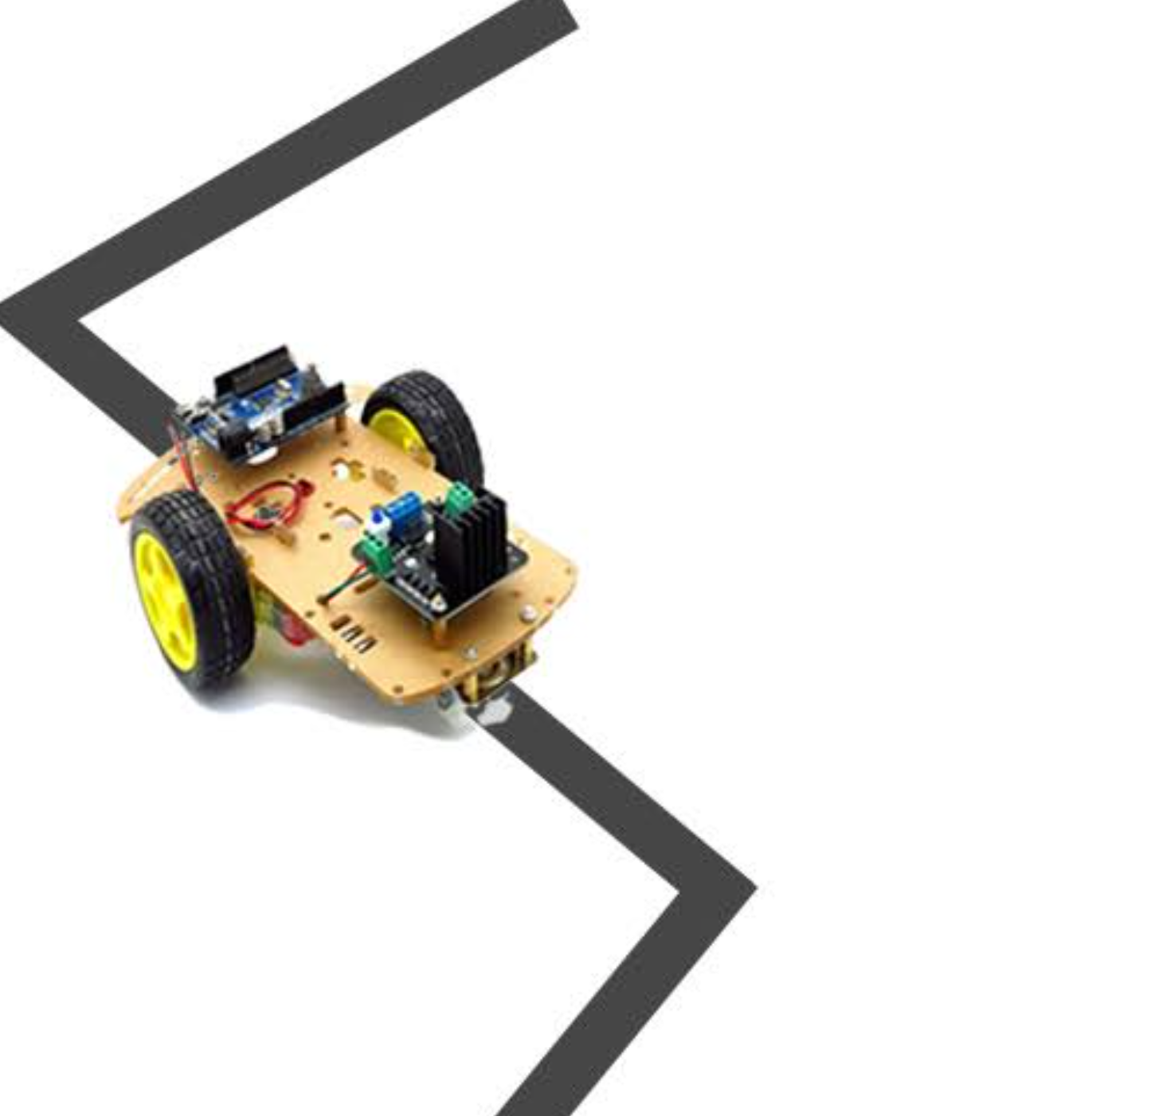

Group Activity
A : Line Following Robot
B : Mini Baymax

Slide 15
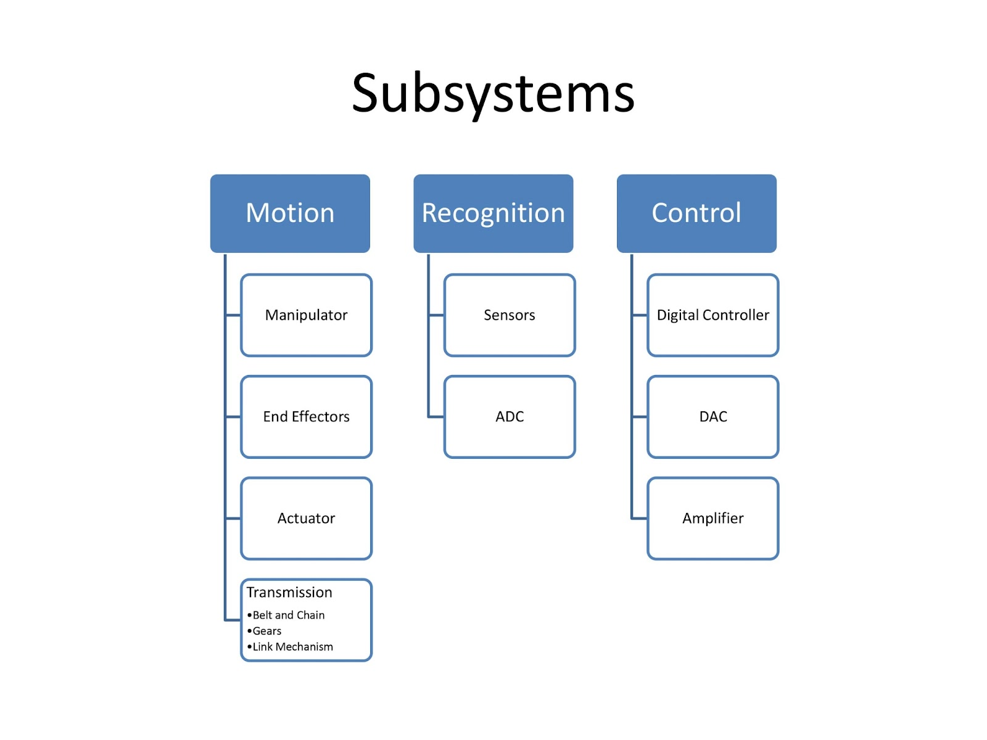

Slide 16
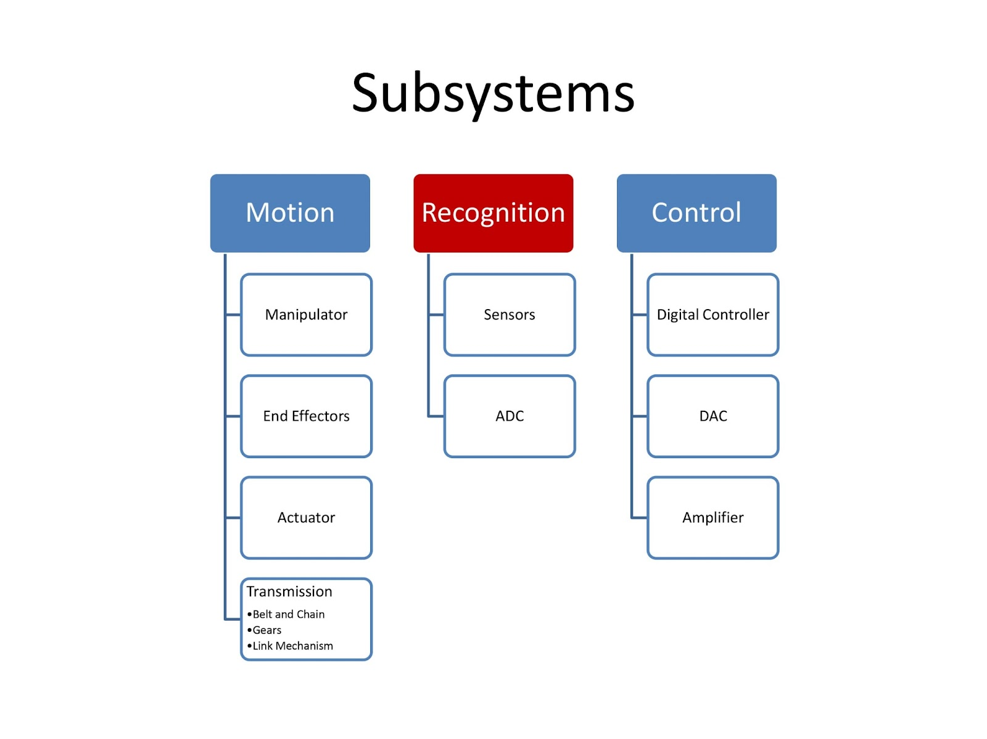

Slide 17
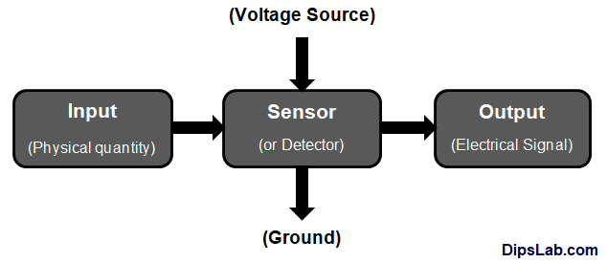
Sensor
A sensor is a device that detects or measures physical, chemical, or biological properties of the environment or a system and converts them into a signal that can be processed or analyzed.

Slide 18
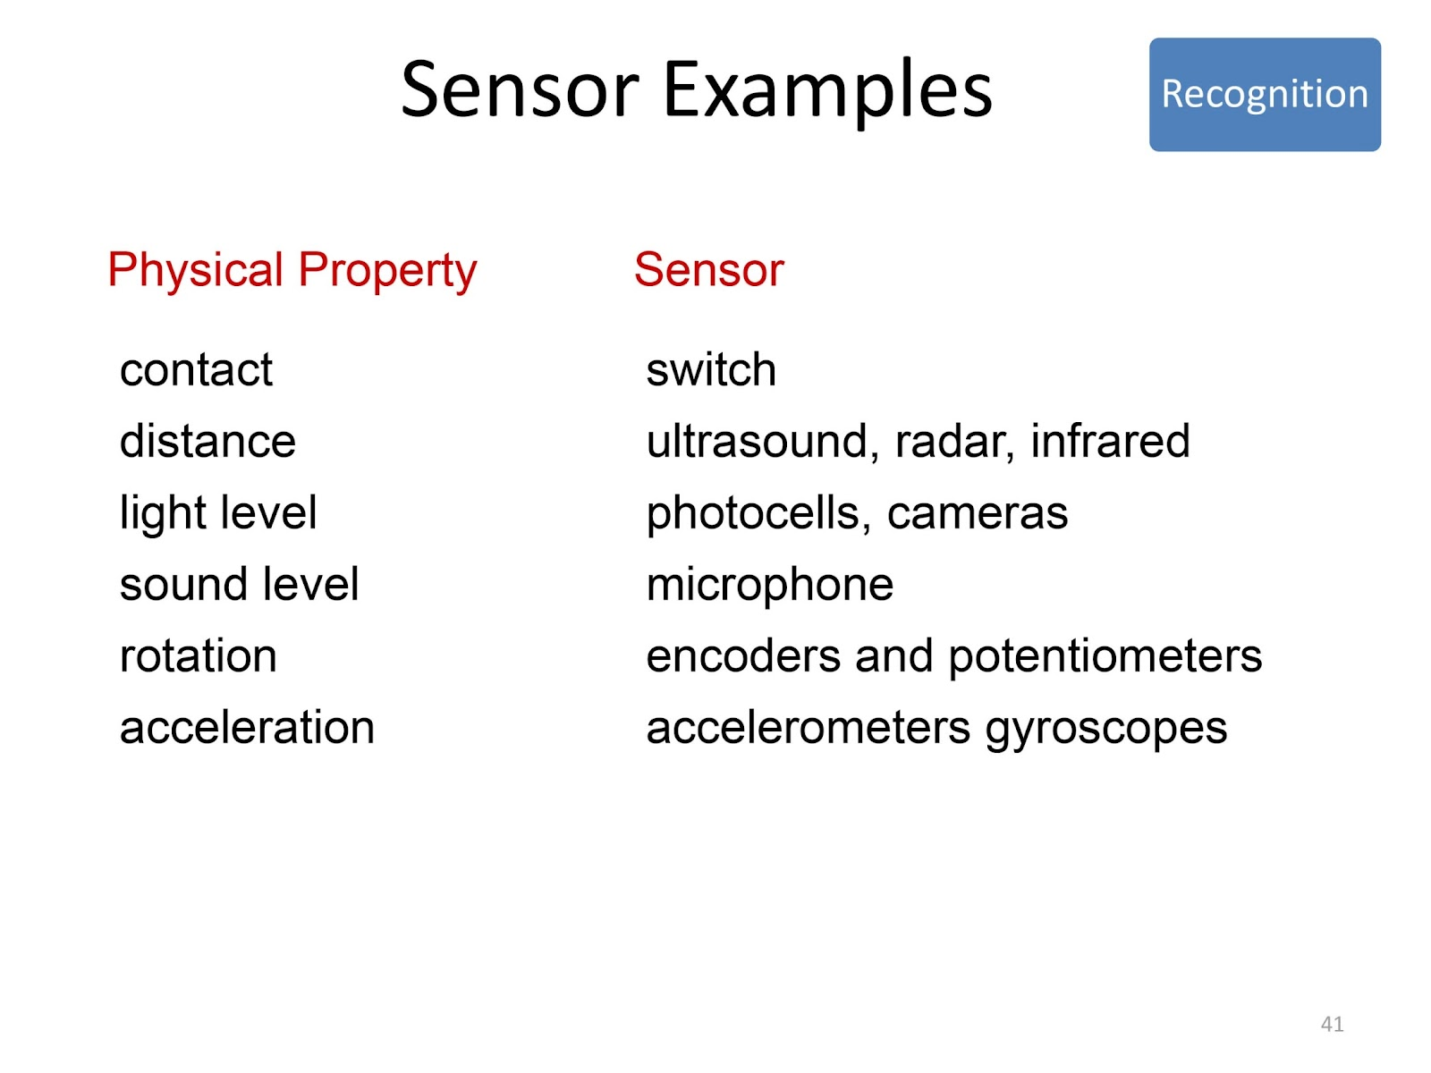

Slide 19
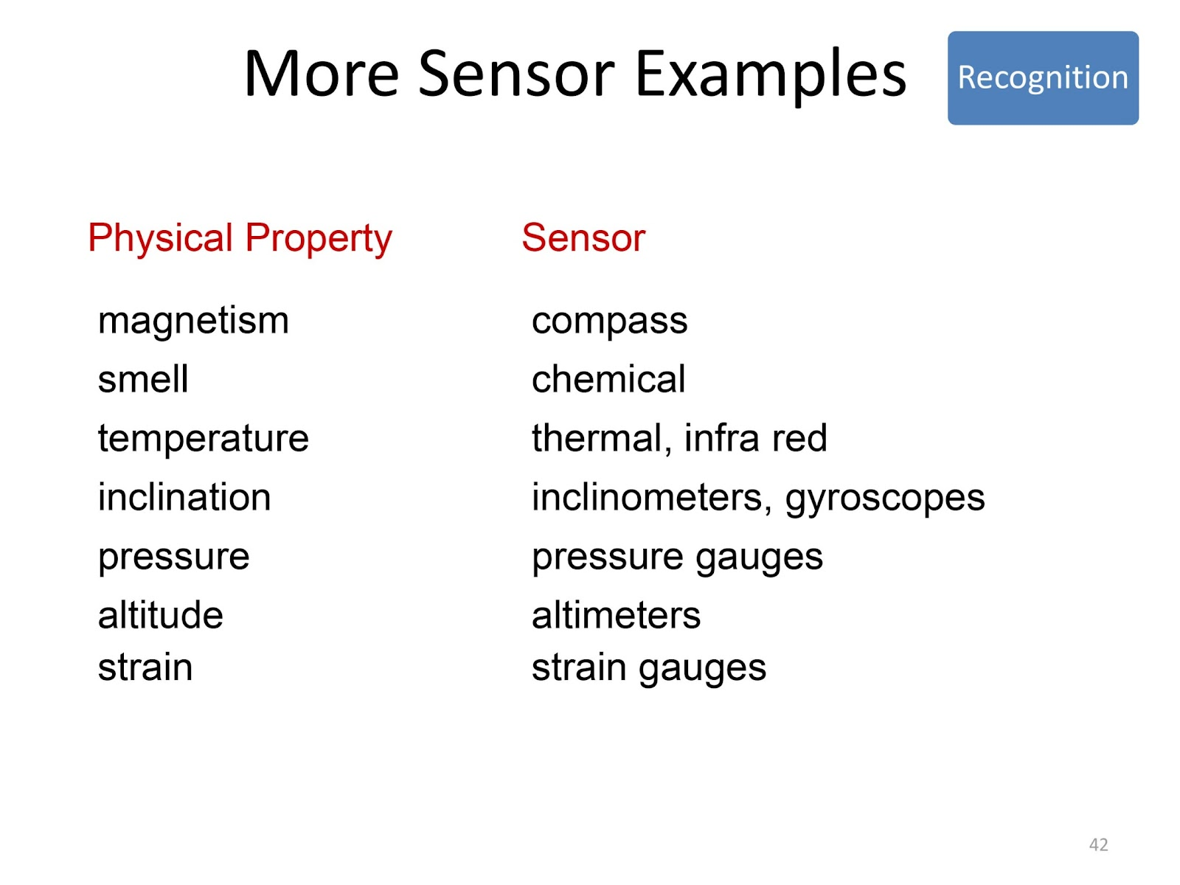

Slide 20
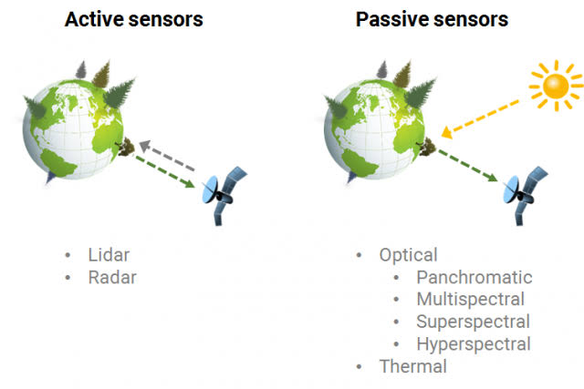

Slide 21
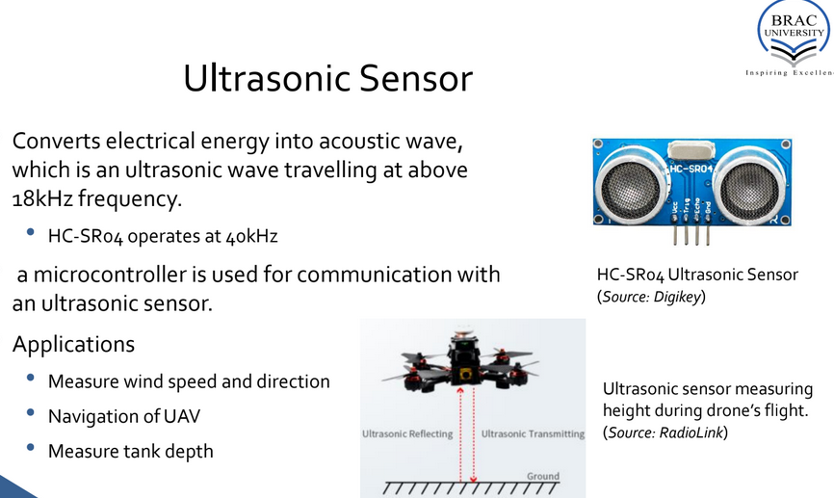

Slide 22
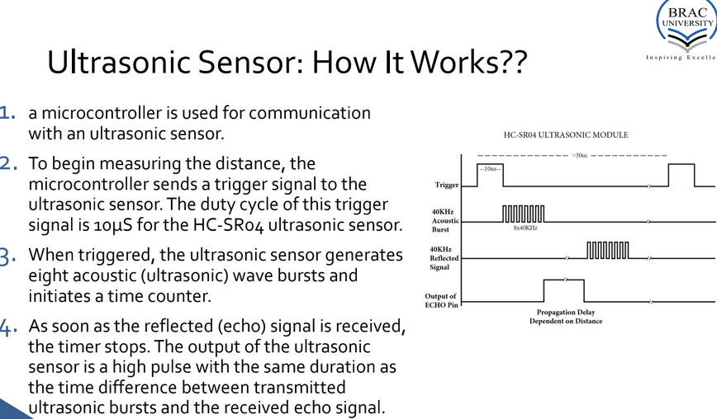

Slide 23
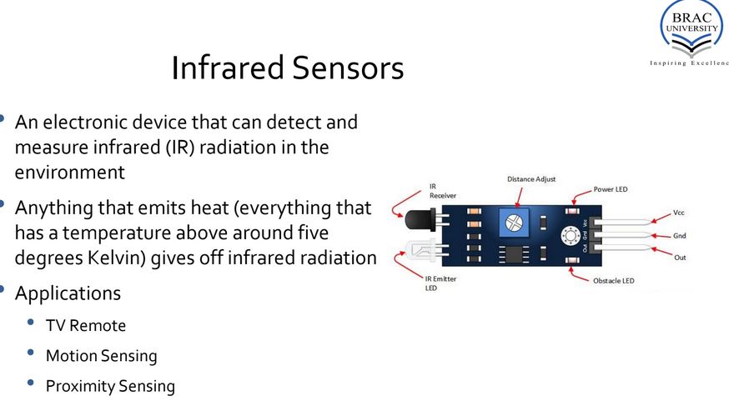

Slide 24
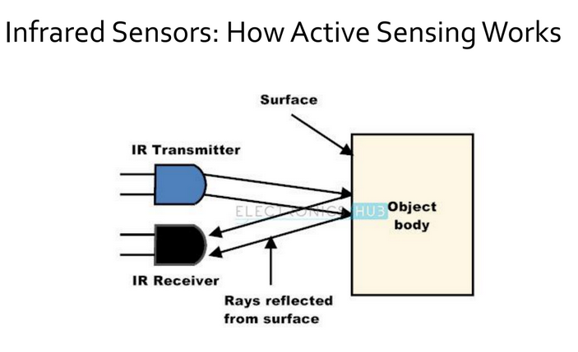

Slide 25
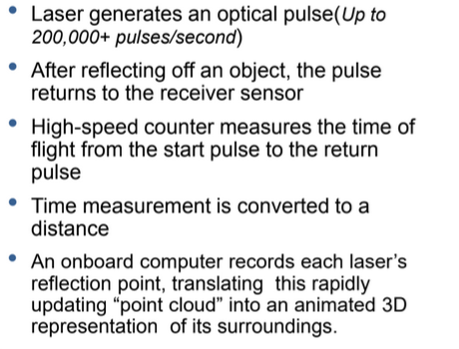
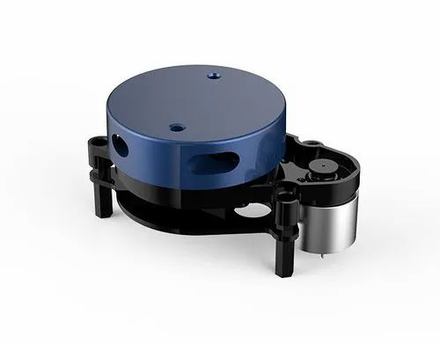
Lidar

Slide 26
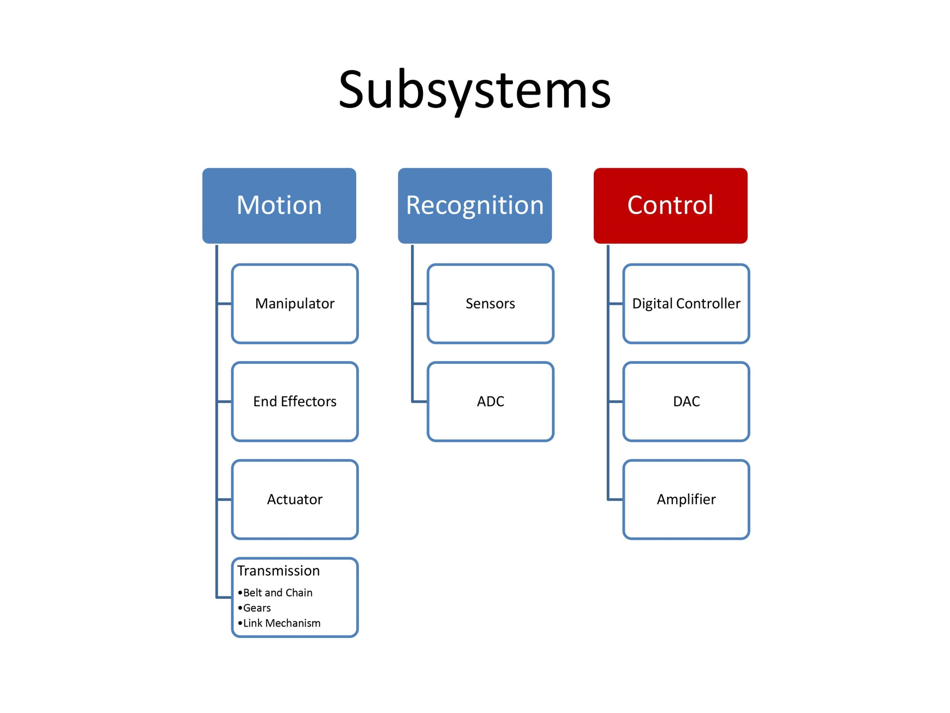

Slide 27
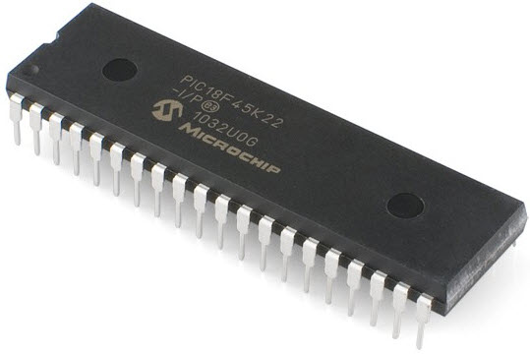
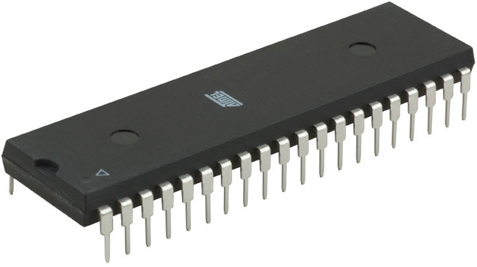
Microcontrollers
A microcontroller is a small, integrated circuit that contains a processor, memory, and input/output peripherals.

Slide 28
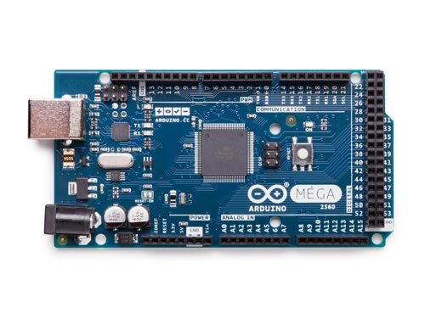

Arduino

Slide 29
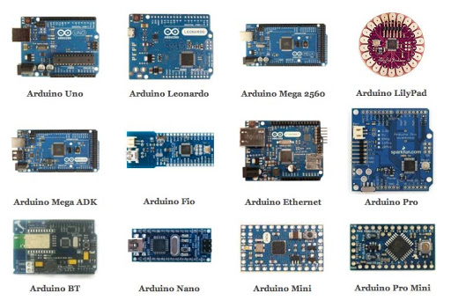
Arduino

Slide 30
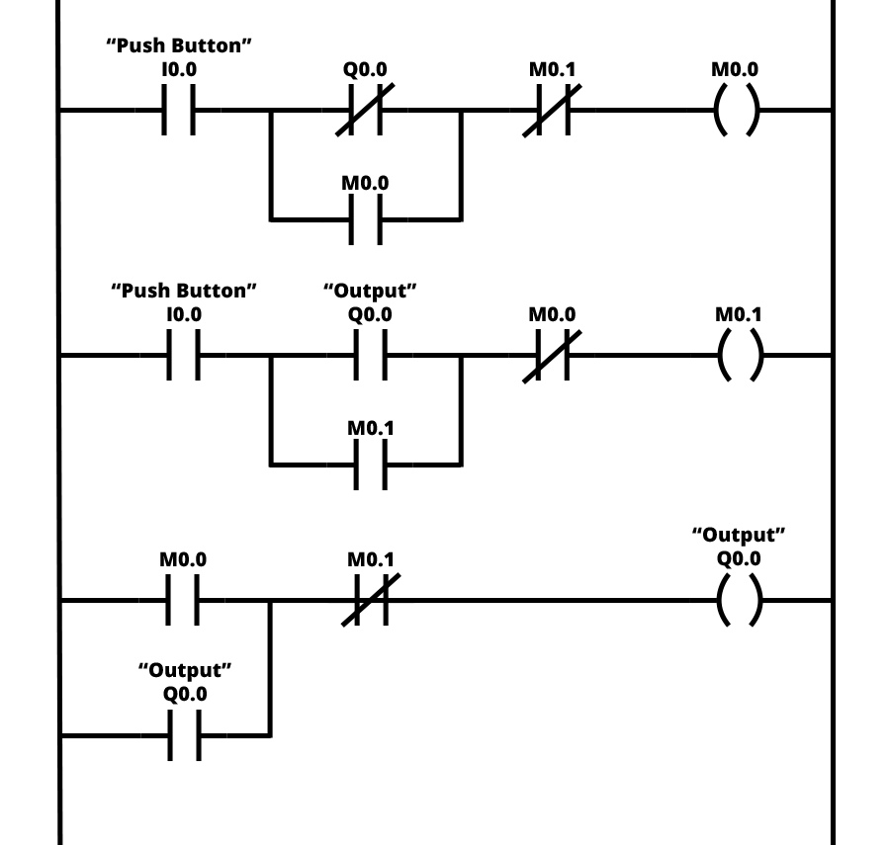
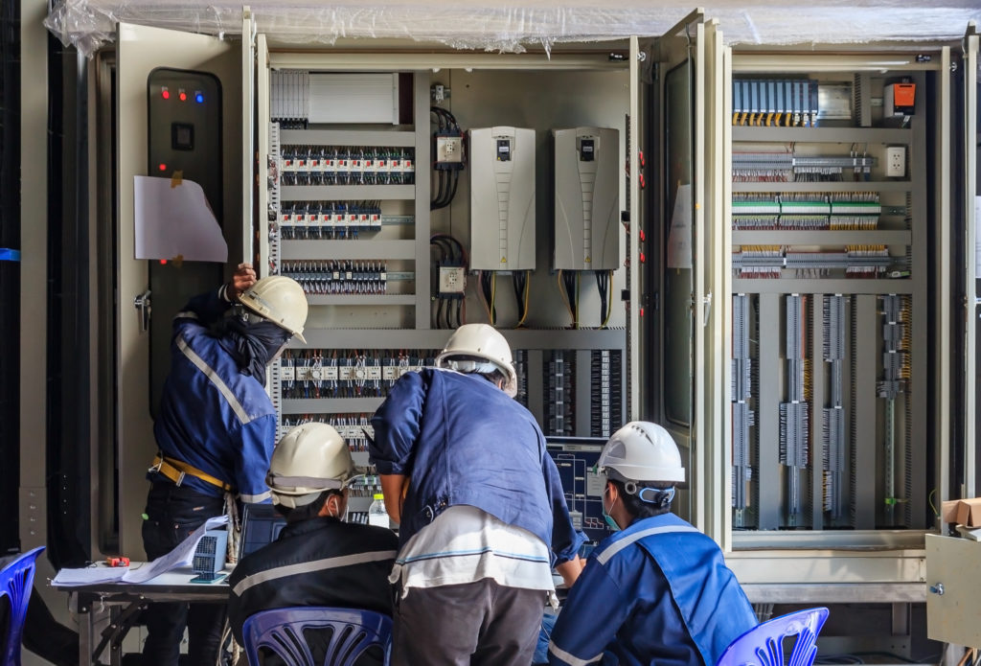
Programmable Logic Controller (PLC)

Slide 31
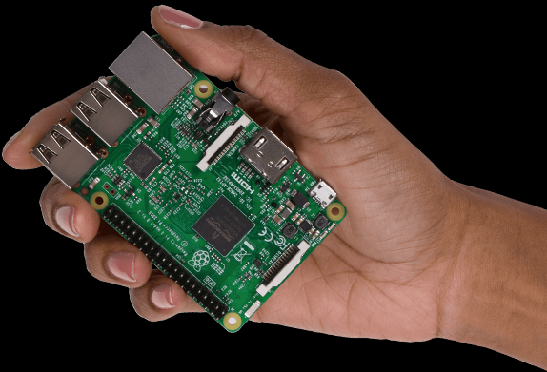
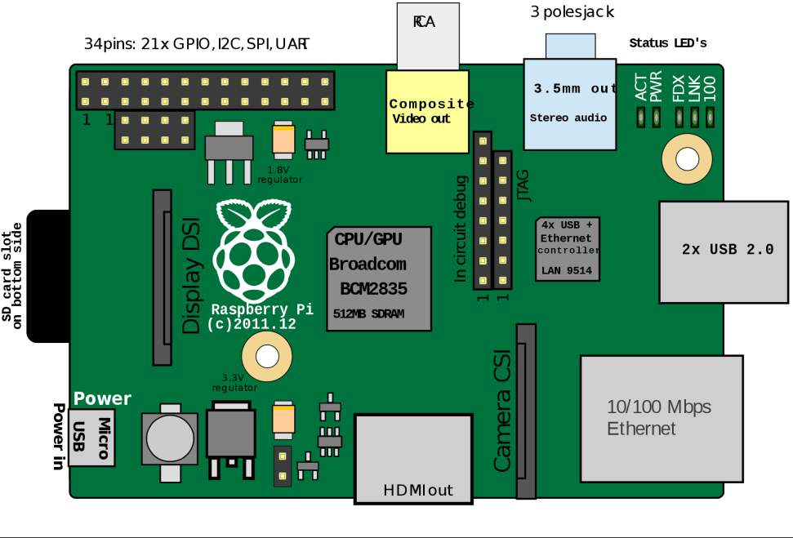
Single board Computer

Slide 32
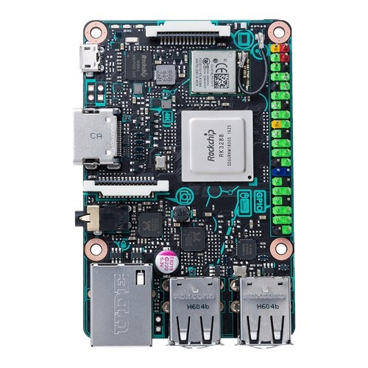
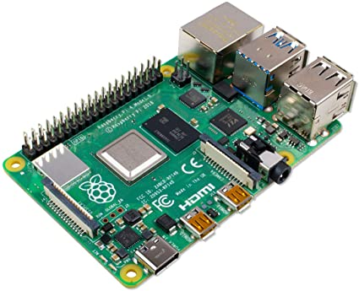
Raspberry PI 4, Tinkerboard

Slide 33
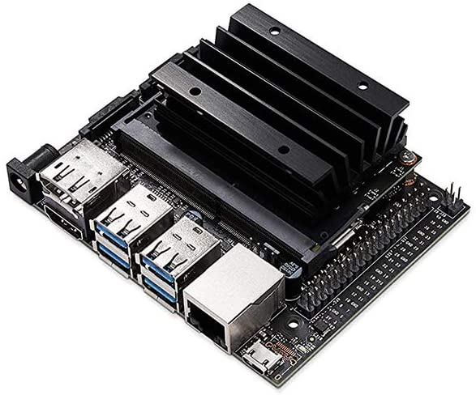
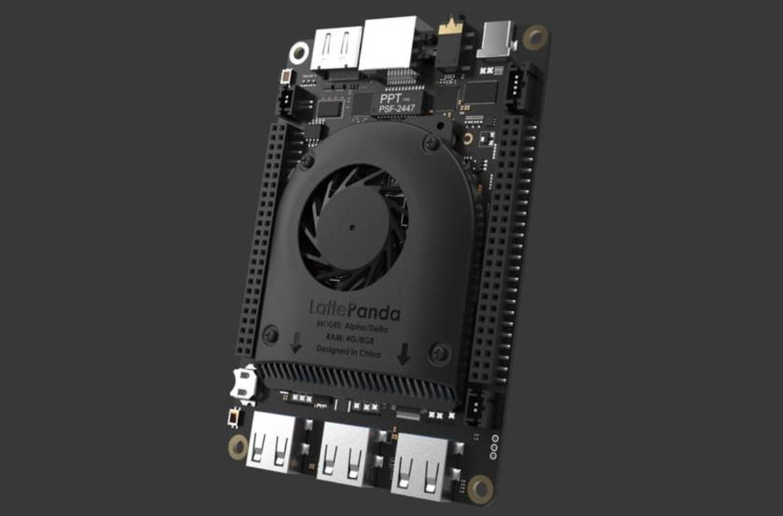
Little Panda and Jetson nano

Slide 34
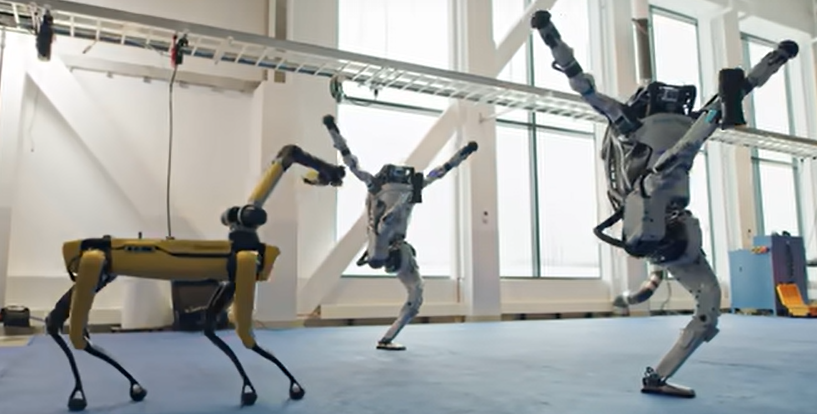
Let’s talk about a dream !
https://www.youtube.com/watch?v=fn3KWM1kuAw

Slide 35
Next Class
Subsystem (Motion)

Slide 36
Thank You

